Slide 1



How Production Location Influences Coffee Characteristics
1-22
Notes:
les caractéristiques du café selon la provenance ?

Slide 2


Summary
Introduction
Data Set presentation
Problematic
Exploratory Data Analysis
Preprocessing
Model Building: Test & Train
Conclusion

Slide 3

INTRODUCTION
DATA SET PRESENTATION
PROBLEMATIC
EXPLORATORY DATA ANALYSIS
PREPROCESSING
MODEL BUILDING: TEST & TRAIN
CONCLUSION
From the retail dataset of fictitious coffee chains.
We wanted to predict the origin of a coffee based on its characteristics....
BUSINESS
APPLICATION
Customer Experience Improvement

Slide 4
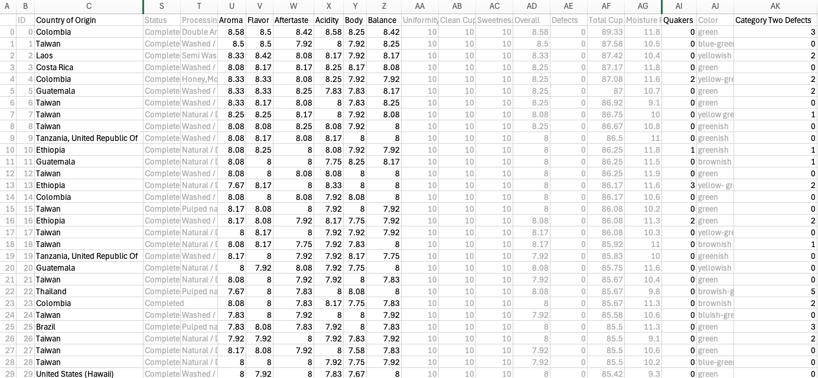
File: Coffee Quality Data (CQI May-2023)
INTRODUCTION
DATA SET PRESENTATION
PROBLEMATIC
EXPLORATORY DATA ANALYSIS
PREPROCESSING
MODEL BUILDING: TEST & TRAIN
CONCLUSION
208 lines
41 columns
Source: Kaggle

Slide 5
From the characteristics of coffee, can we predict its origin?
INTRODUCTION
DATA SET PRESENTATION
PROBLEMATIC
EXPLORATORY DATA ANALYSIS
PREPROCESSING
MODEL BUILDING: TEST & TRAIN
CONCLUSION

Slide 6
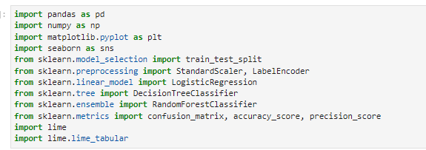
INTRODUCTION
DATA SET PRESENTATION
PROBLEMATIC
EXPLORATORY DATA ANALYSIS
PREPROCESSING
MODEL BUILDING: TEST & TRAIN
CONCLUSION
Import of libraries and functions that we will need

Slide 7
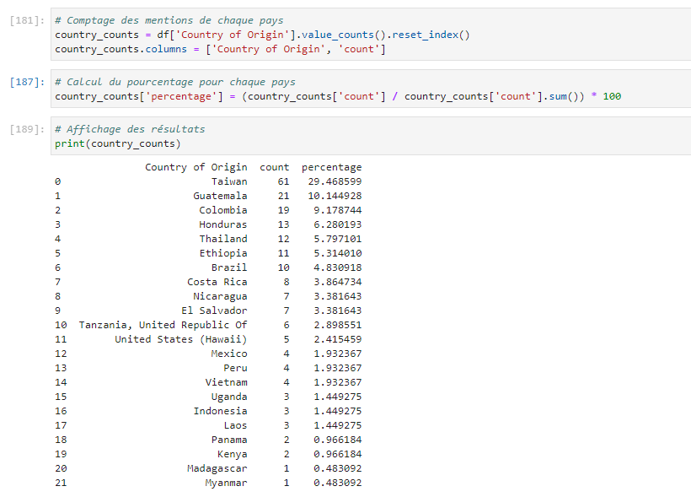
INTRODUCTION
DATA SET PRESENTATION
PROBLEMATIC
EXPLORATORY DATA ANALYSIS
PREPROCESSING
MODEL BUILDING: TEST & TRAIN
CONCLUSION
These first 7 countries represent more than 70% of total production ( 71.01449275362319) :
Taiwan, Guatelama, Colombia, Honduras, Thailand, Ethiopia, Brazil

Slide 8
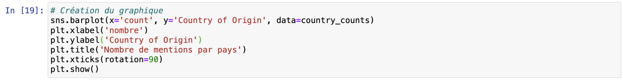
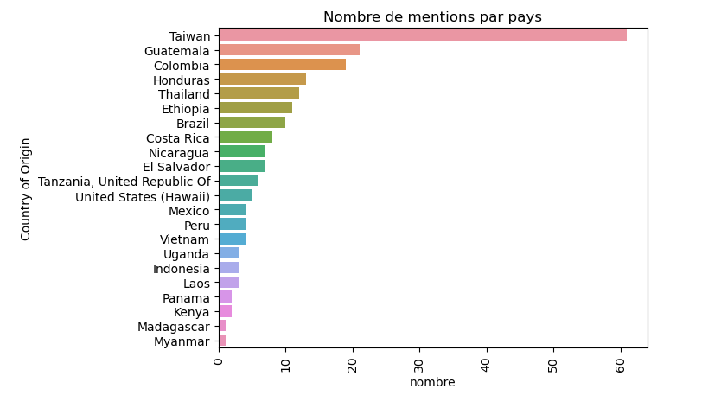
INTRODUCTION
DATA SET PRESENTATION
PROBLEMATIC
EXPLORATORY DATA ANALYSIS
PREPROCESSING
MODEL BUILDING: TEST & TRAIN
CONCLUSION
Visualization of these results in graph form

Slide 9
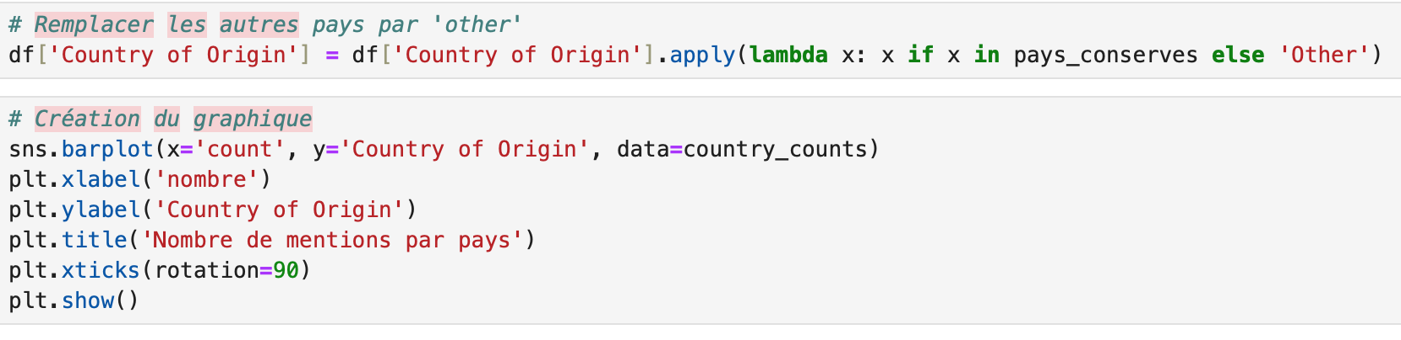
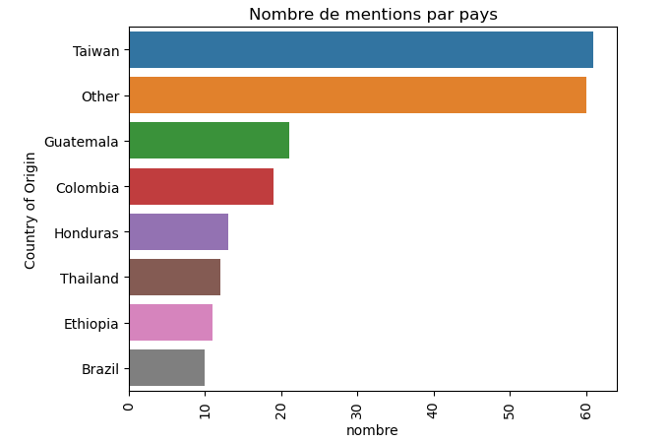
INTRODUCTION
DATA SET PRESENTATION
PROBLEMATIC
EXPLORATORY DATA ANALYSIS
PREPROCESSING
MODEL BUILDING: TEST & TRAIN
CONCLUSION
Representation of these results in graph form with Other.
Other represents 30% of lines and comes in second position after Taiwan

Slide 10
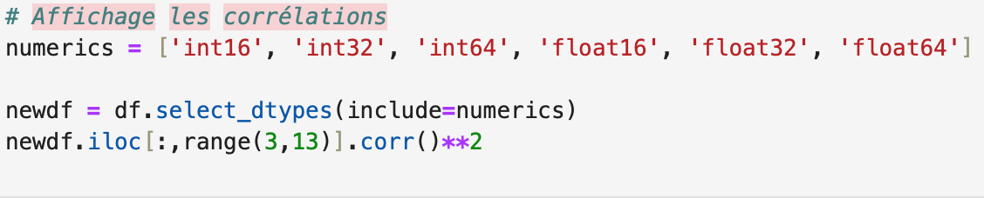
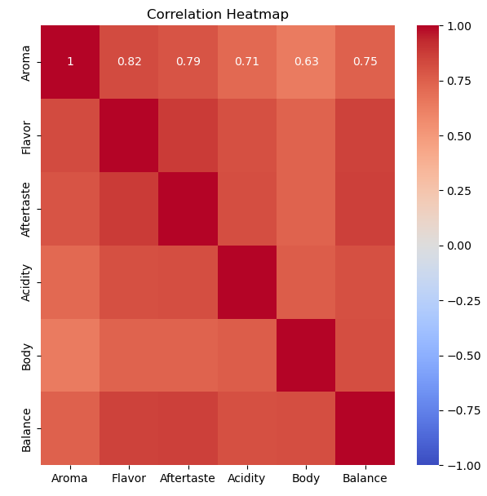
INTRODUCTION
DATA SET PRESENTATION
PROBLEMATIC
EXPLORATORY DATA ANALYSIS
PREPROCESSING
MODEL BUILDING: TEST & TRAIN
CONCLUSION
To choose the features we have applied the correlation formula andtook the features scored over 0.5

Slide 11
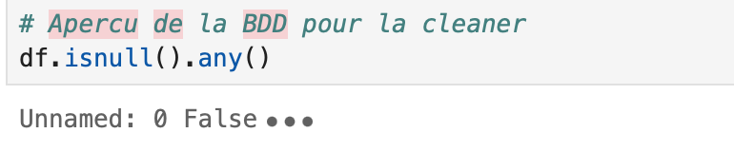
Methodology
INTRODUCTION
DATA SET PRESENTATION
PROBLEMATIC
EXPLORATORY DATA ANALYSIS
PREPROCESSING
MODEL BUILDING: TEST & TRAIN
CONCLUSION
Missing values
Separate target
Standardize data
Label encoding

Slide 12
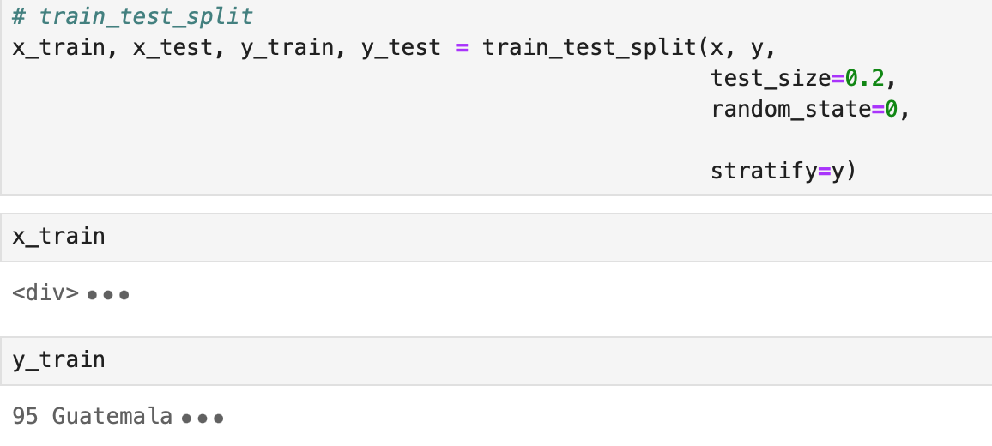
Methodology
INTRODUCTION
DATA SET PRESENTATION
PROBLEMATIC
EXPLORATORY DATA ANALYSIS
PREPROCESSING
MODEL BUILDING: TEST & TRAIN
CONCLUSION
Missing values
Separate target
Standardize data
Label encoding

Slide 13
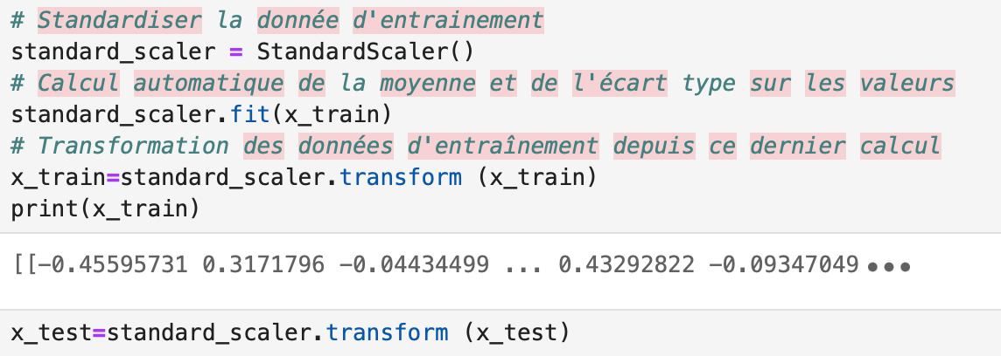
Methodology
INTRODUCTION
DATA SET PRESENTATION
PROBLEMATIC
EXPLORATORY DATA ANALYSIS
PREPROCESSING
MODEL BUILDING: TEST & TRAIN
CONCLUSION
Missing values
Separate target
Standardize data
Label encoding

Slide 14
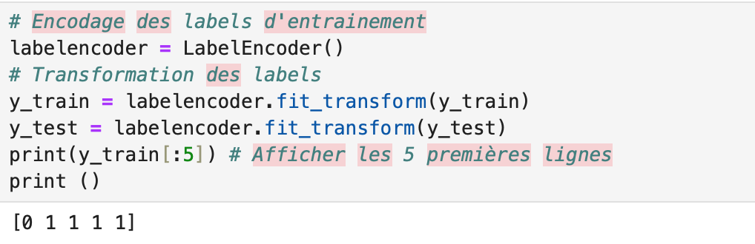
Methodology
INTRODUCTION
DATA SET PRESENTATION
PROBLEMATIC
EXPLORATORY DATA ANALYSIS
PREPROCESSING
MODEL BUILDING: TEST & TRAIN
CONCLUSION
Missing values
Separate target
Standardize data
Label encoding

Slide 15

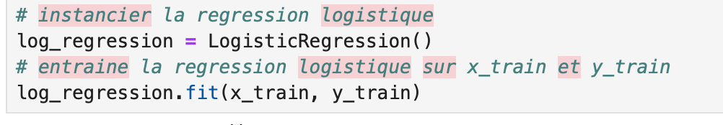
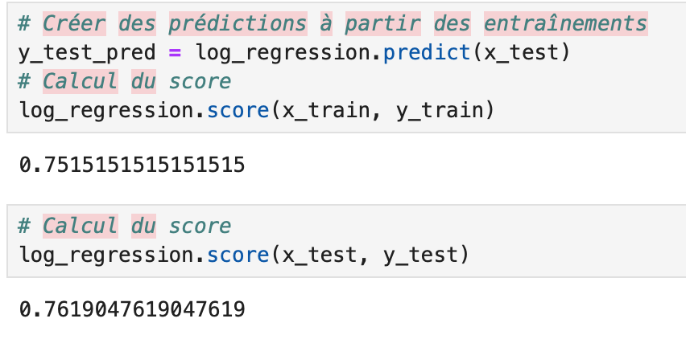
INTRODUCTION
DATA SET PRESENTATION
PROBLEMATIC
EXPLORATORY DATA ANALYSIS
PREPROCESSING
MODEL BUILDING: TEST & TRAIN
CONCLUSION
Regression logistic: Test & Result
Accuracy Score
Phase 1 Test: 30%
Phase 2 Test: 63%
Phase 3 Test: 70%
Notes:
test 1 = y = country (7 pays) x = 6 caractéristiques ⇒ résultat insuffisant test 2 = y = country (2+1 pays) x = 6 caractéristiques ⇒ résultat insuffisant test 3 = y = country (2+1 pays) x = 6 caractéristiques + ajout de 2 Category 2 Defect + Quakers ⇒ résultat satisfaisant

Slide 16

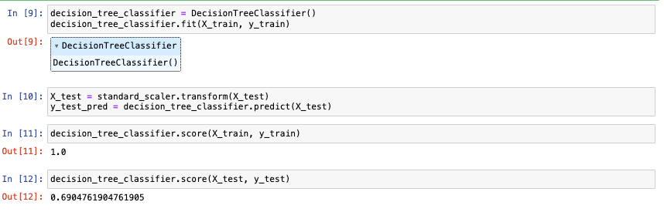
INTRODUCTION
DATA SET PRESENTATION
PROBLEMATIC
EXPLORATORY DATA ANALYSIS
PREPROCESSING
MODEL BUILDING: TEST & TRAIN
CONCLUSION
Decision Tree: Test & Result
Accuracy Score
Overfitting , train score : 100%
We have tried to adjust the hyperparameters, but it wasn’t enough to go over it

Slide 17

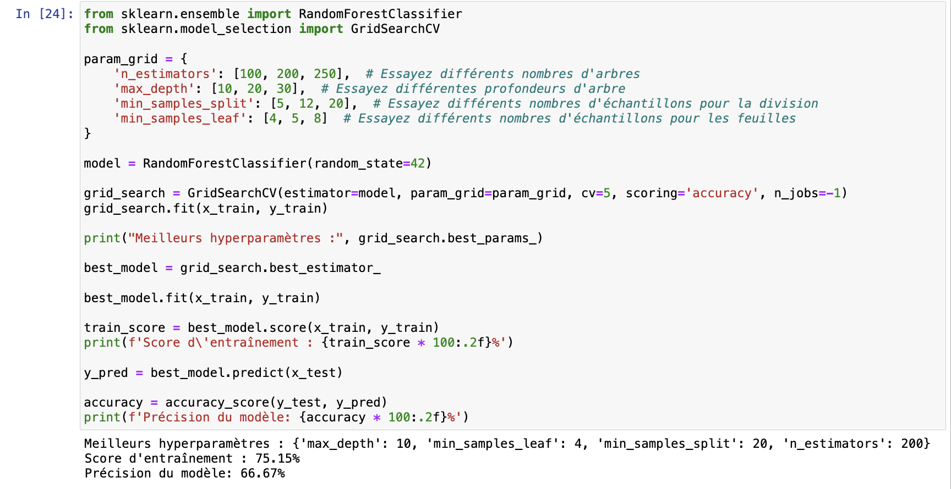
INTRODUCTION
DATA SET PRESENTATION
PROBLEMATIC
EXPLORATORY DATA ANALYSIS
PREPROCESSING
MODEL BUILDING: TEST & TRAIN
CONCLUSION
Random Forest: Test & Result
Accuracy Score - Same data as for previous model
Overfitting , train score : 100%
With Adjusted hyperparameters = we achieved a training score of 75% with a model accuracy test of 66%.

Slide 18
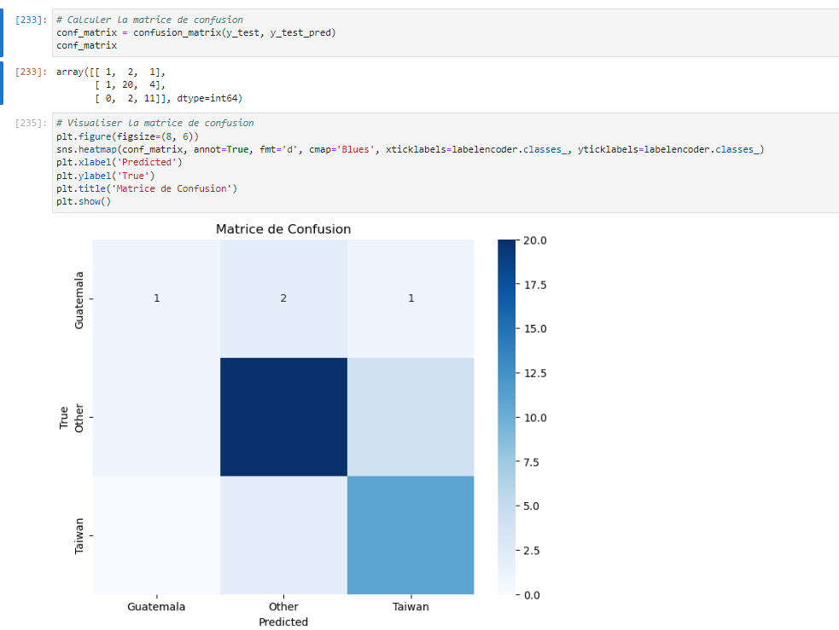
INTRODUCTION
DATA SET PRESENTATION
PROBLEMATIC
EXPLORATORY DATA ANALYSIS
PREPROCESSING
MODEL BUILDING: TEST & TRAIN
CONCLUSION
Notes:
# Pour le Guatemala, le modèle a correctement prédit 1 instance comme appartenant à cette classe, a prédit à tort 2 instances comme appartenant à la classe 1 (Other), et a prédit à tort 1 instance comme appartenant à la classe 2 (Taiwan).
# Pour Other, le modèle a correctement prédit 20 instances comme appartenant à cette classe, a prédit à tort 1 instance comme appartenant à la classe 0 (Guatemala), et a prédit à tort 4 instances comme appartenant à la classe 2 (Taiwan).
# Pour Taiwan, le modèle n'a pas prédit correctement d'instances comme appartenant à cette classe, mais a prédit à tort 2 instances comme appartenant à la classe 1 (Other).

Slide 19
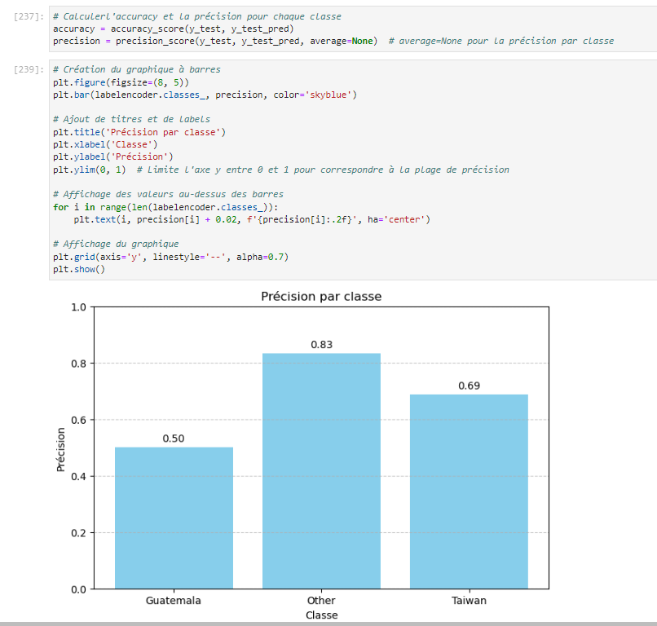
INTRODUCTION
DATA SET PRESENTATION
PROBLEMATIC
EXPLORATORY DATA ANALYSIS
PREPROCESSING
MODEL BUILDING: TEST & TRAIN
CONCLUSION
Notes:
R Squared / Coefficient de détermination En statistique, le coefficient de détermination linéaire de Pearson, noté R2 ou r2, est une mesure de la qualité de la prédiction d'une régression linéaire

Slide 20
INTRODUCTION
DATA SET PRESENTATION
PROBLEMATIC
EXPLORATORY DATA ANALYSIS
PREPROCESSING
MODEL BUILDING: TEST & TRAIN
CONCLUSION
After testing differents models,
we have noted that the logistic regression model is able to recognize the coffee's origin at 76% from its characteristics, without Overfitting.

Slide 21
Thanks !
Notes:
les caractéristiques du café selon la provenance ?

